Slide 1
Protecting user password keys at rest
TEAM – MACHINE MINDSET

Slide 2
Problem statement
To design and develop a program to Protecting User Password Keys at rest(on the Disk) using different types of Encryption algorithms.

Slide 3
Unique ideas
Develop a system that leverages hybrid encryption combining AES and RSA algorithms for secure file sharing. AES is used to encrypt files with a randomly generated File Encryption Key (FEK), while RSA encrypts the FEK for secure distribution to authorized recipients. Access control is dynamically managed through RSA keys, ensuring only designated users with the corresponding private keys can decrypt and access files. This approach integrates robust security measures such as bcrypt for password hashing and authentication, making it suitable for environments requiring stringent confidentiality and controlled access to sensitive data.

Slide 4
Features offered
AES-256 Encryption : Uses Advanced Encryption Standard (AES) with a 256-bit key length for strong encryption.
Password-Based Key Derivation (PBKDF2) : Generates cryptographic keys from passwords using PBKDF2-HMAC-SHA256.
RSA Key Encryption :Utilizes RSA (Rivest-Shamir-Adleman) for asymmetric encryption.
Secure File Handling: Implements secure file handling for encrypted files and associated metadata.
User Interaction : Provides a user-friendly command-line interface (CLI) for encryption and decryption operations.

Slide 5
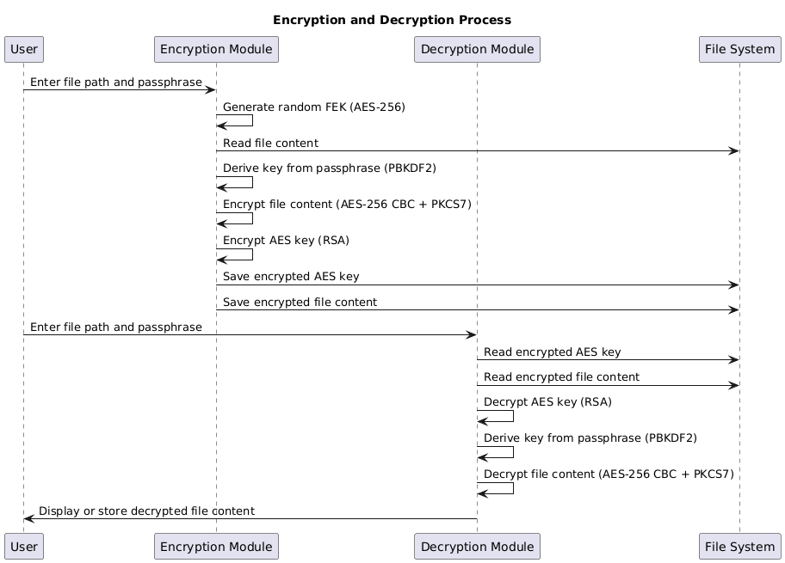
Process flow

Slide 6
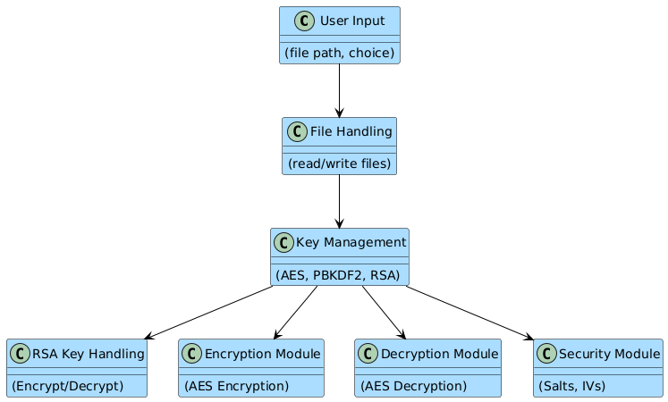
Architecture diagram

Slide 7
Technologies used
Python: Programming language providing flexibility and extensive libraries.
Cryptography: Cryptography library for AES encryption, RSA key management, key derivation (PBKDF2), padding (PKCS7), and serialization.
Operating System: Os module for file operations and random byte generation.
Secure Input: Getpass module for securely obtaining the passphrase from the user.
Password Hashing: bcrypt library for securely hashing passwords before storage

Slide 8
Team members and contribution
M Deepa : RSA Key Generation and Management.
Mahesh Ghorpade M : AES Encryption and Decryption.
Indra M : File Encryption and Decryption.
Keerthana S : Password Hashing.
Manoj B:Integration and Testing.

Slide 9
Conclusion
The program provides a robust method for securely encrypting and decrypting files using AES-256 in CBC mode, leveraging passphrase-derived keys with PBKDF2 for enhanced security. It ensures data integrity by using padding and managing encryption keys securely. This implementation highlights the effective use of modern cryptographic techniques to protect sensitive information in Python applications.

Slide 10
THANK YOU

